Slide 1
TEAM 8 : KICKING ASSETS
Ananya
Aryan
Atharv
Bharath
Kshama
Mythreya

Slide 2
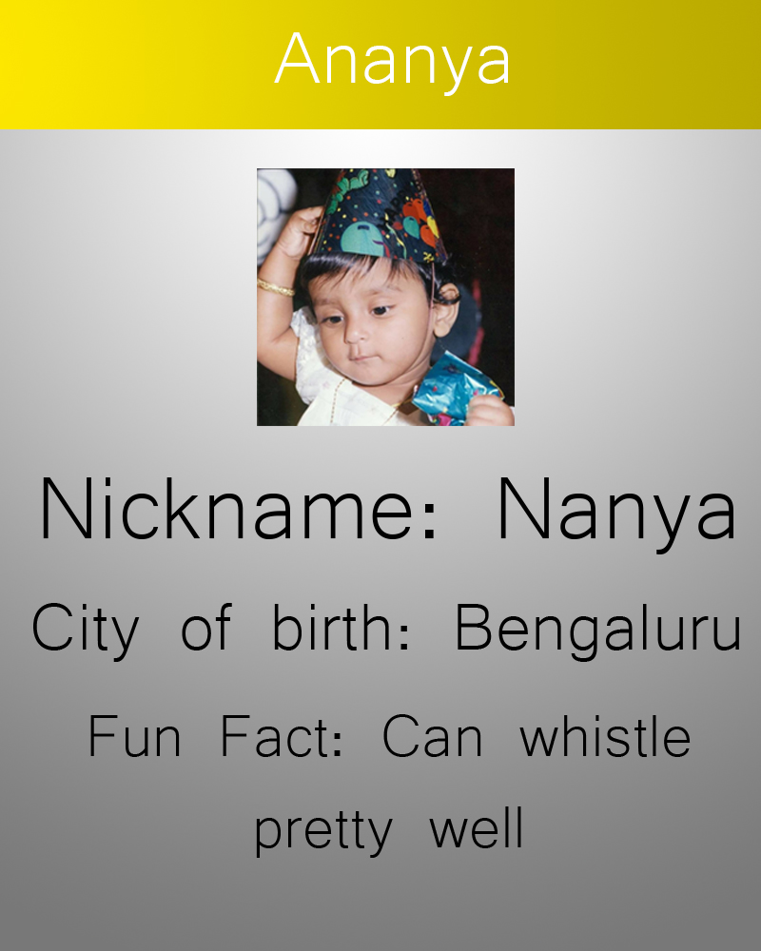
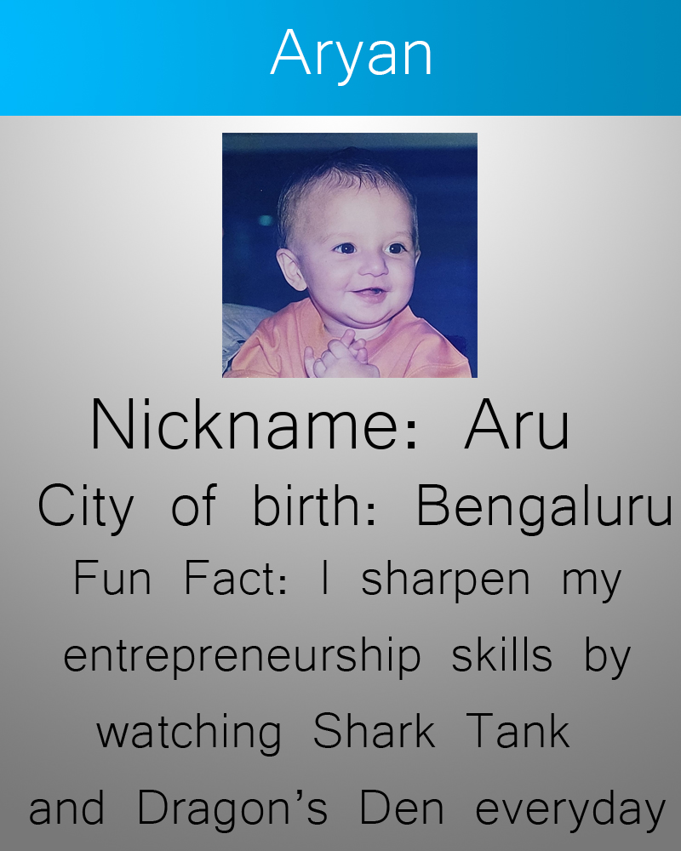
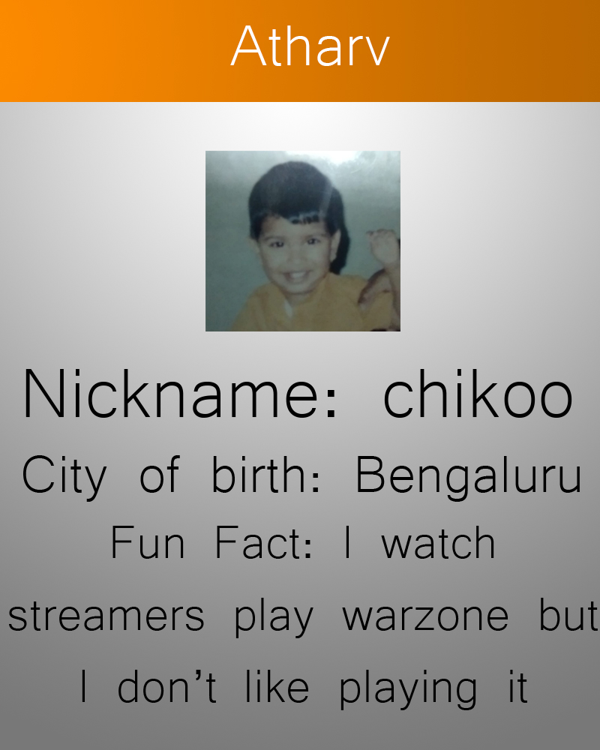
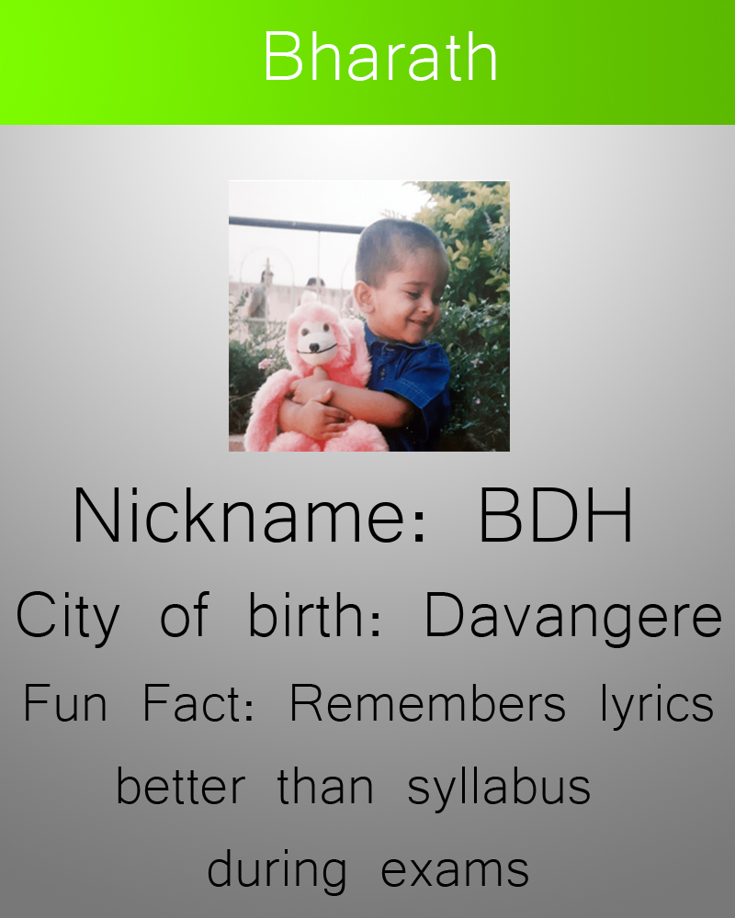
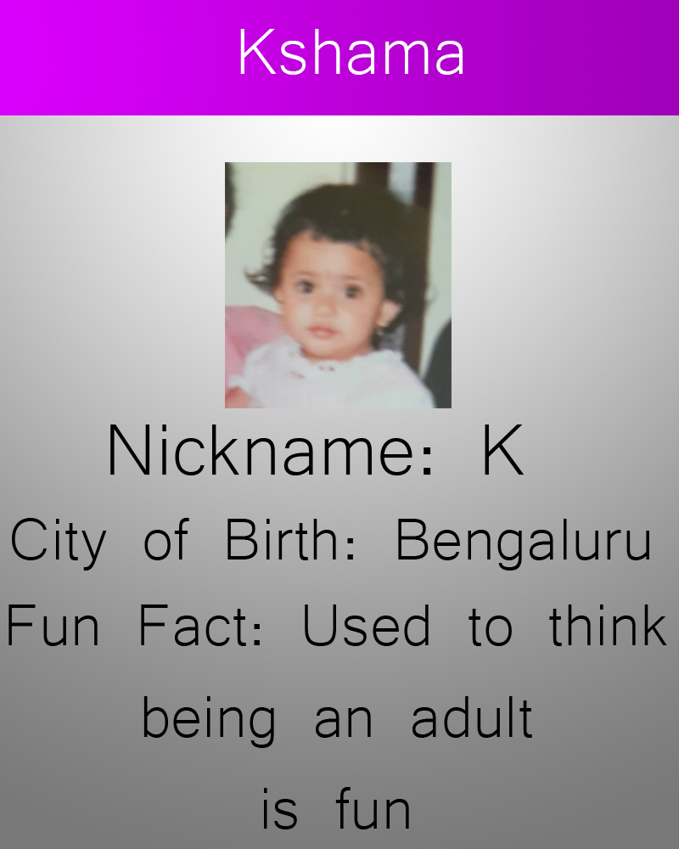
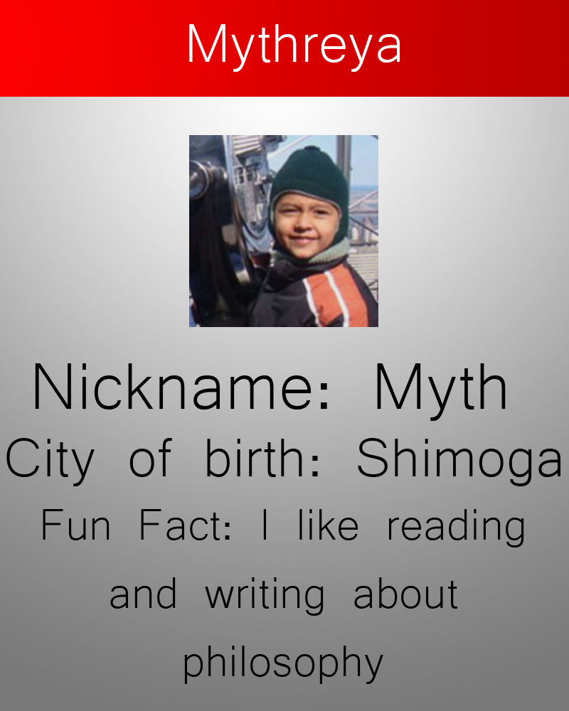
Our trading cards

Slide 3
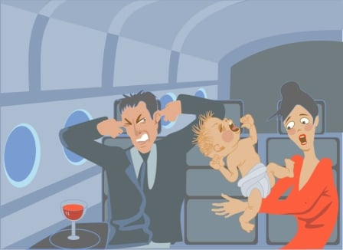
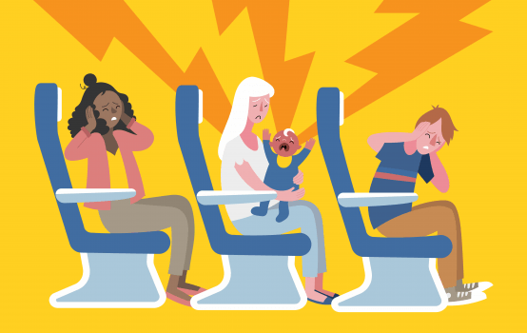
Have you as a passenger ever encountered a crying baby mid-air?

Slide 4
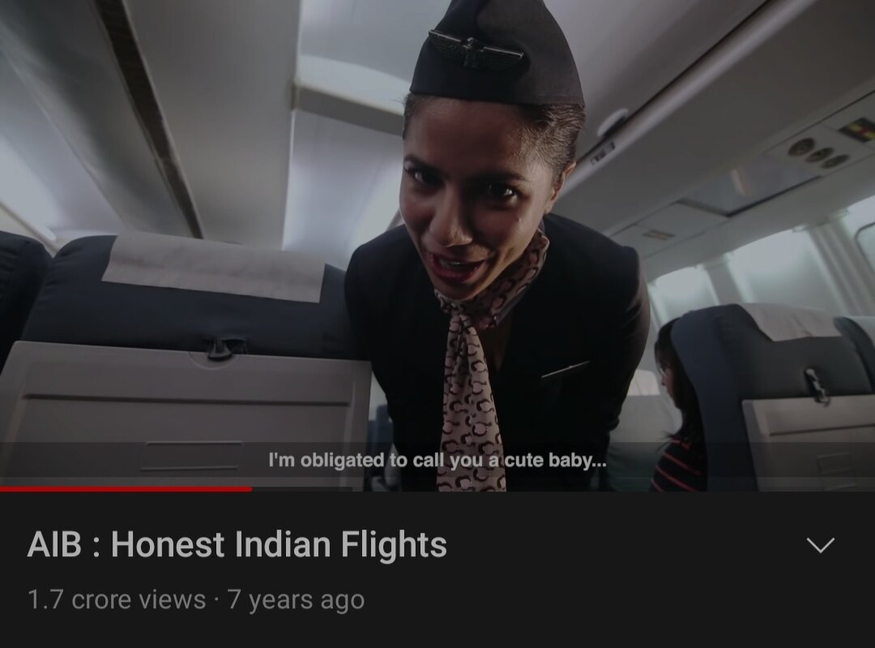
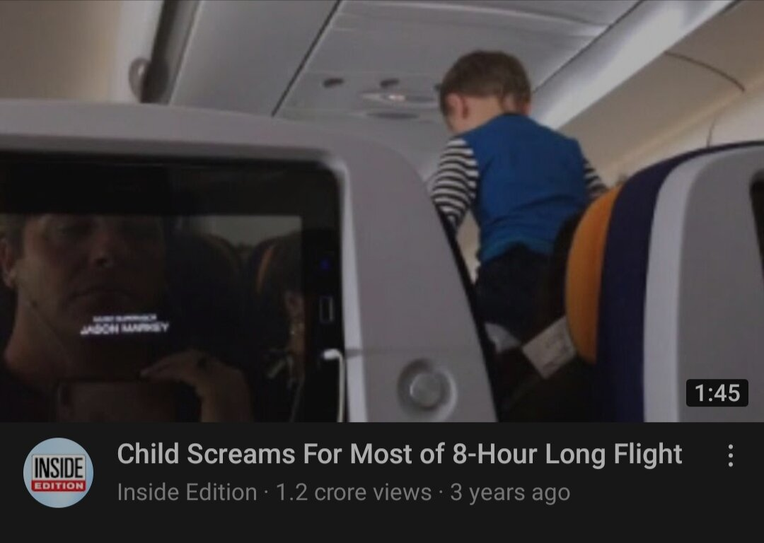
This is an issue that has been highlighted a lot in media too

Slide 5
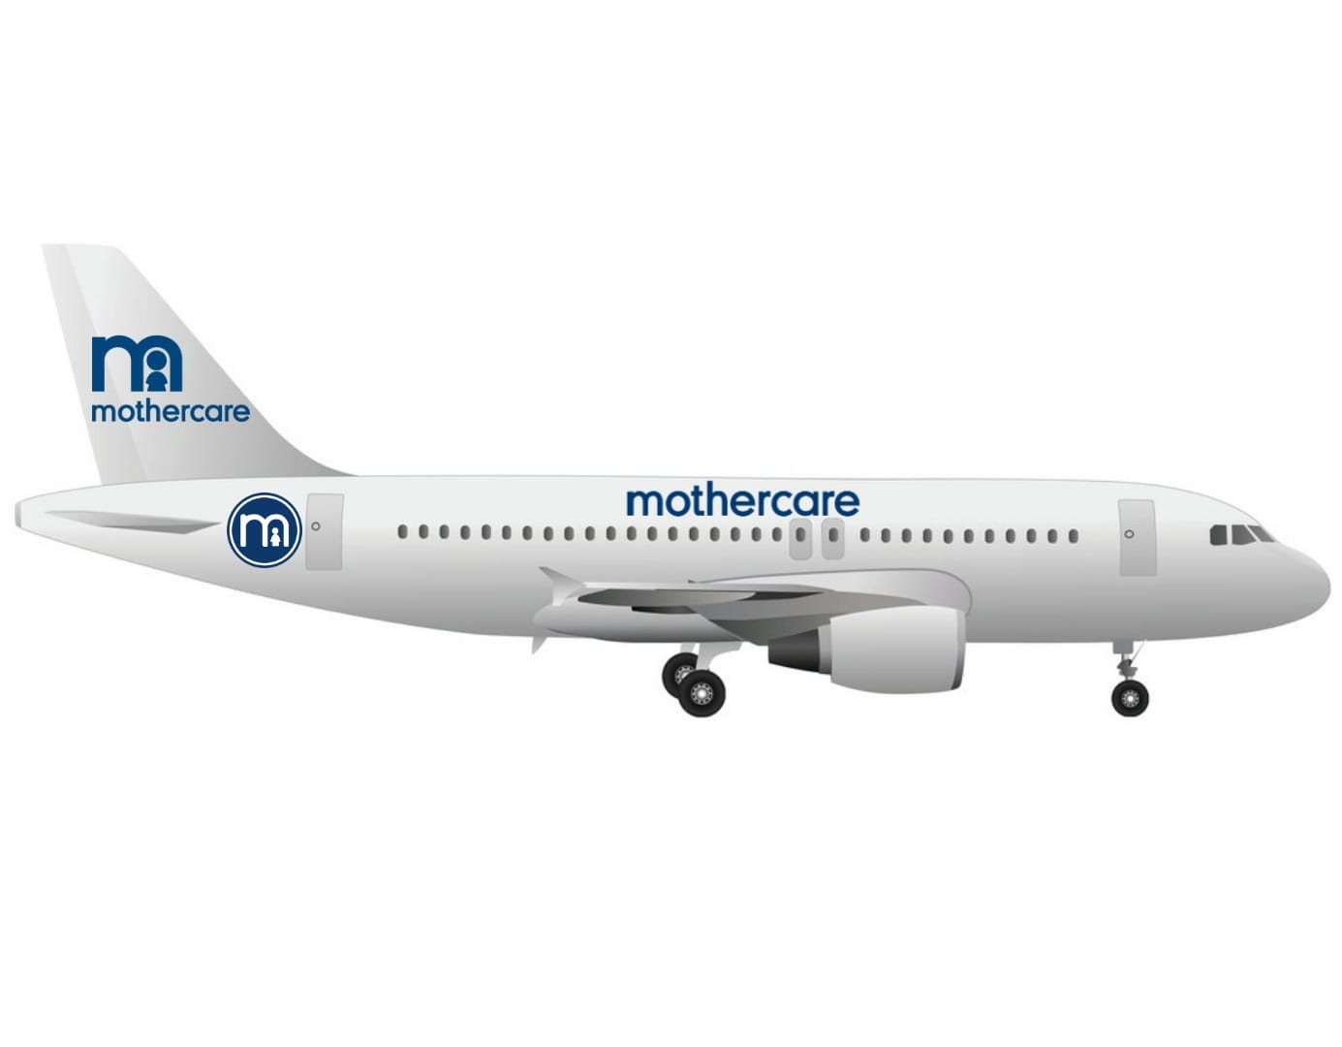

This is where we step in with our product…..
airlines

Slide 6

PRODUCT
We decided to solve a common issue faced by passengers as well as parents and their children, traveling by air.

Slide 7
INSPIRATION
Innovation stemmed from being aware of problems in our surroundings and producing a creative solution for them.
This product is aligned with Mothercare’s vision - “help parents and children create their life story”; and what better way to enhance life's story than providing a safe and comfortable travel catering to all needs a parent or child could possibly have.

Slide 8
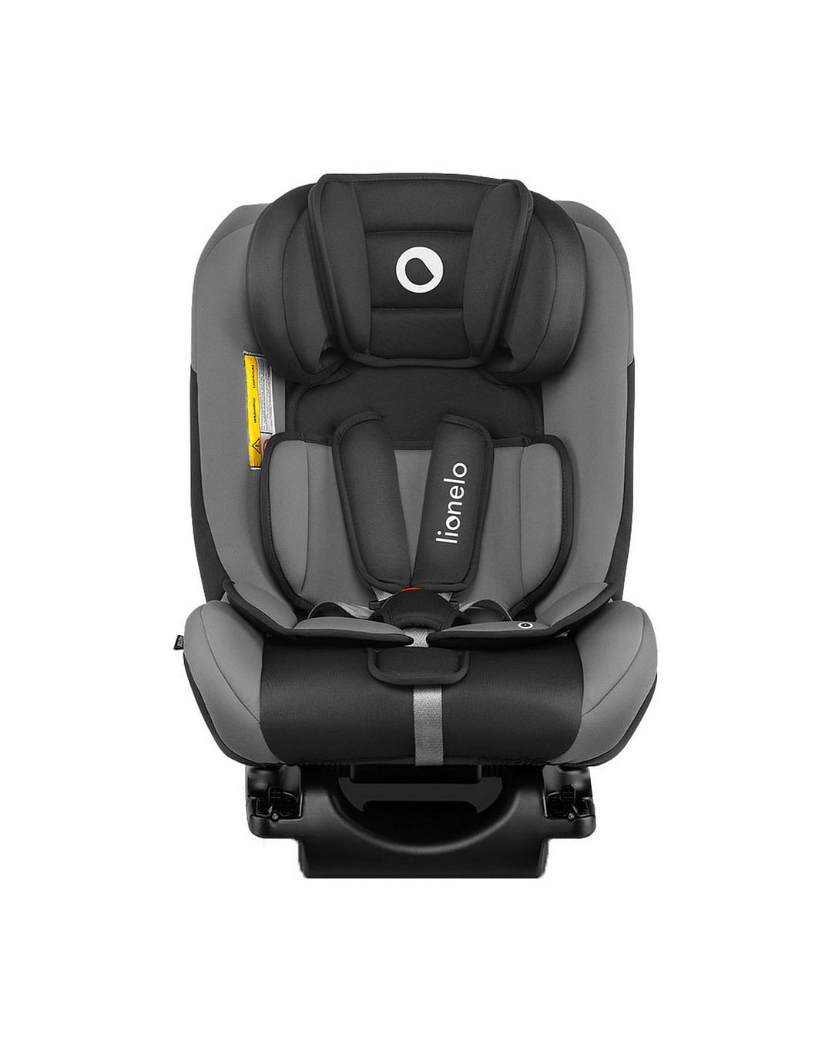
FEATURES
Special Compartment
01
A separate compartment for kids and mothers
Sound-proof walls
02
The compartment has soundproof walls for a better travel experience for all the passengers.
Baby seats
03
Specialized comfortable and turbulence-safe baby seats for toddlers and newborns (like car seats but plane friendly ).
In flight nannies
04
Flight attendants who are also trained nannies and babysitters.

Slide 9
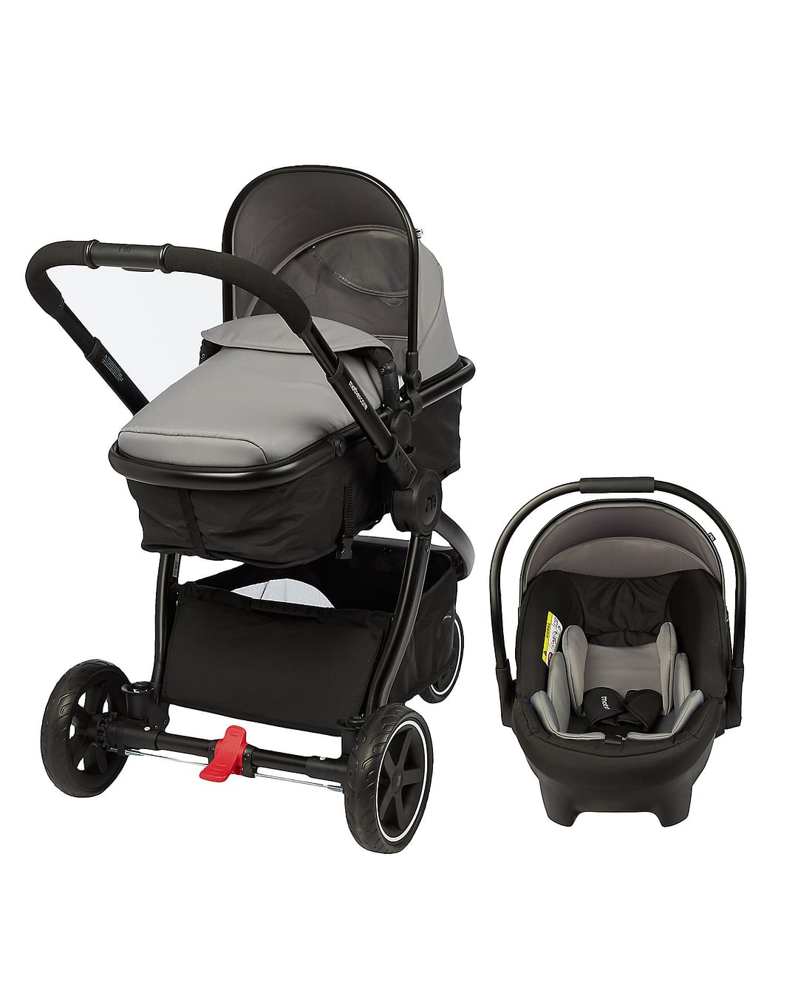
FEATURES
Baby care room
Hygienic area for the parents to comfortably cater to the needs of the child.
( Diaper Changing station, Private area for nursing)
05
Toddler friendly room
06
Has a reasonably sized play area.
Helps keep children engaged, leading to lesser crying fits and tantrums during the flight.
Baby stroller
07
A mother care stroller service is available at the airport for the convenience of the parents
Inflight Duty-free
08
Mothercare shop onboard with baby food and essentials.

Slide 10
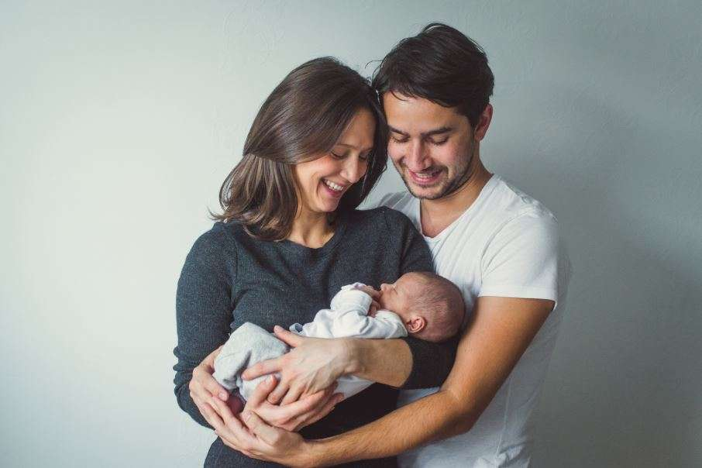
TARGET AUDIENCE
Parent who wishes to travel hassle-free with their toddler.

Slide 11
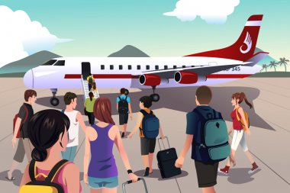
TARGET AUDIENCE
2. Passengers looking for a peaceful flight without any baby-related inconveniences.

Slide 12
Promotional Ideas
Ads that target
nursery rhymes, cartoons, or Parenting channels
YouTube
Mom-fluencers on social media
Instagram
Advertising in Mothercare stores nationwide & play
areas in malls.
Stores & Play areas
Ticket discount
Promotional offers in Mothercare stores on clocking bill of a
certain amount.
Coupons
Coupons for Mothercare products in-flight.

Slide 13

BENEFITS
Hassle free travel for parents worried about long flight journeys.
Comfortable travel for passengers without having to worry about crying/cranky babies on flight.
Happy Passenger
Happy Baby

Slide 14
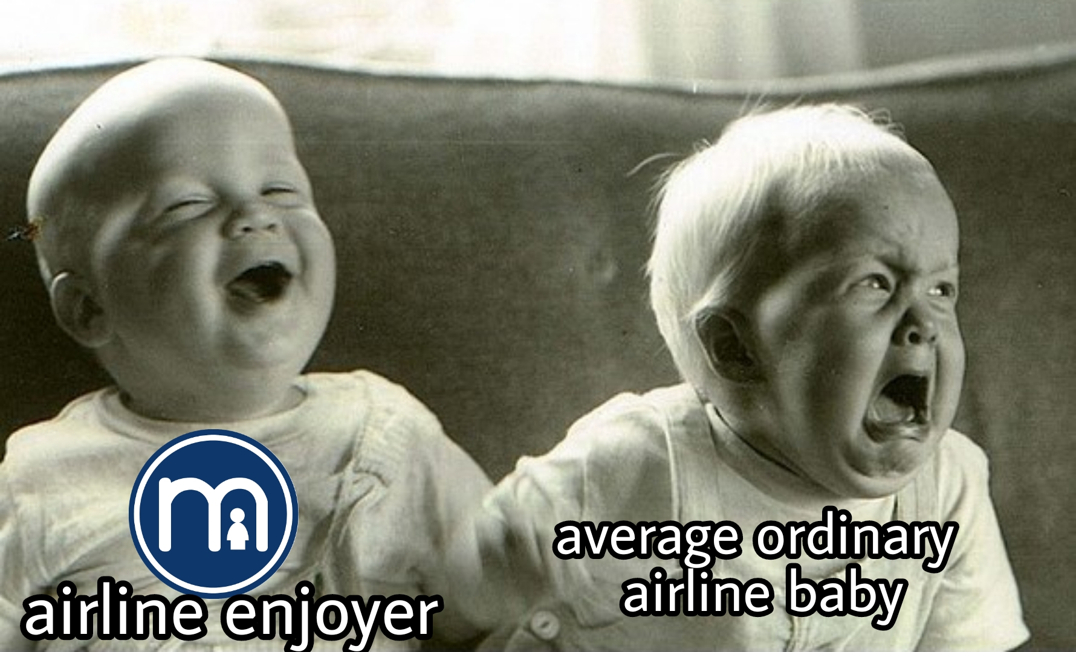
In case you still don’t get what, we do

Slide 15
THANK YOU

